Slide 1
Zero-shot Learning

Slide 2
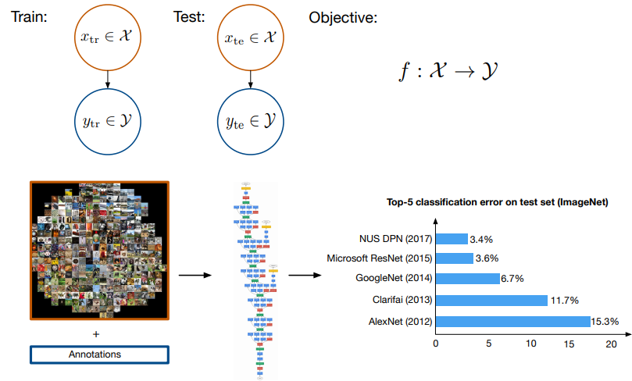
Related topics
Many shot Learning (supervised learning)

Slide 3
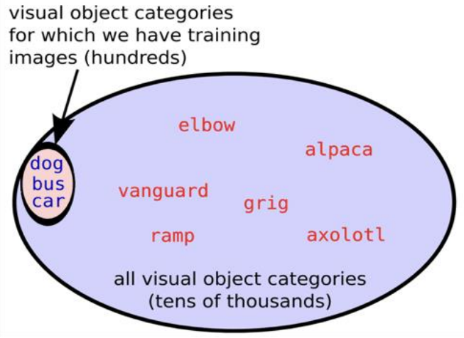
Related topics
One-shot learning: One-shot learning aims to learn information about object categories from one, or only a few, training images

Slide 4
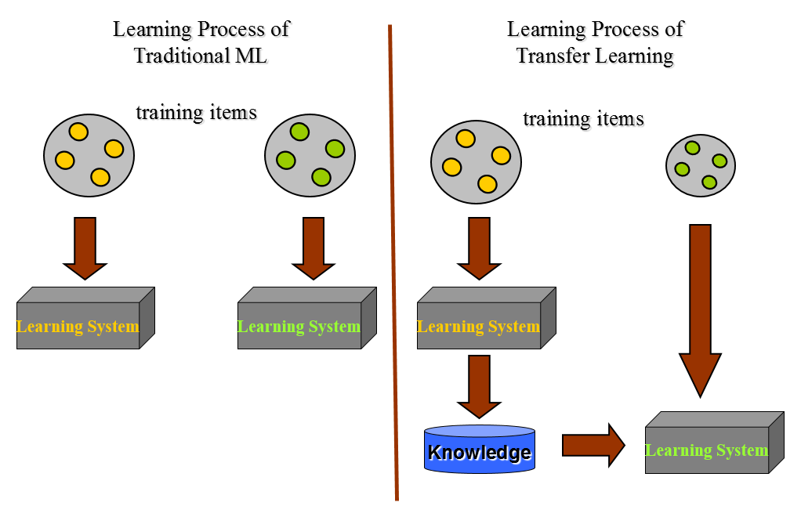
Related topics
Transfer learning: The ability of a system to recognize and apply knowledge and skills learned in previous tasks to novel tasks (in new domains)
Source domain: plenty of labeled data
Target domain: labeled data are in short supply
Task relatedness: share some common knowledge

Slide 5
Related topics
Multi-task learning
Domain Adaptation
Sample selection bias
Covariate shift

Slide 6
An overview of
various settings of
transfer learning
Self-taught Learning
Case 1
No labeled data in a source domain
Inductive Transfer Learning
Labeled data are available in a source domain
Labeled data are available in a target domain
Source and target tasks are learnt simultaneously
Multi-task Learning
Case 2
Transfer Learning
Labeled data are available only in a source domain
Assumption: different domains but single task
Transductive Transfer Learning
Domain Adaptation
No labeled data in both source and target domain
Assumption: single domain and single task
Unsupervised Transfer Learning
Sample Selection Bias /Covariance Shift

Slide 7
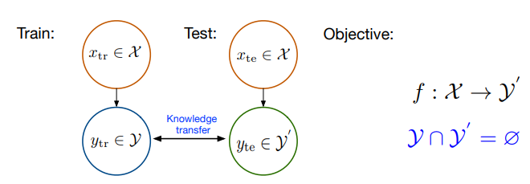
Zero-shot learning
New categories always emerging when testing
One-shot learning: some classes have no training examples
Transfer learning: transfer the knowledge from seen classes to unseen classes

Slide 8
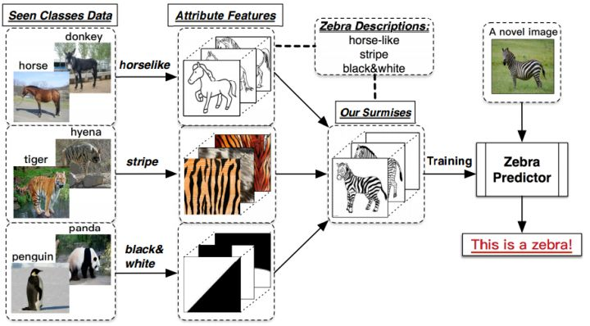
An example

Slide 9
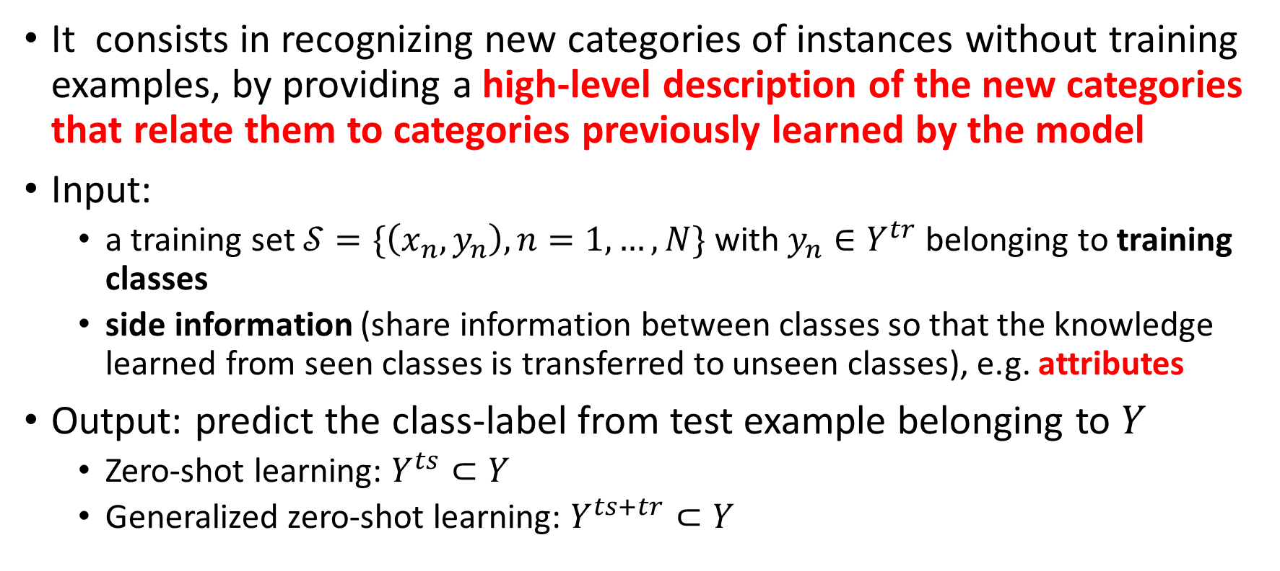
Problem setting
It consists in recognizing new categories of instances without training examples, by providing a high-level description of the new categories that relate them to categories previously learned by the model
Input:
a training set $𝒮=\{\left(x_{n},y_{n}\right),n=1,…,N\}$ with $y_{n}∈Y^{tr}$ belonging to training classes
side information (share information between classes so that the knowledge learned from seen classes is transferred to unseen classes), e.g. attributes
Output: predict the class-label from test example belonging to $Y$
Zero-shot learning: $Y^{ts}⊂Y$
Generalized zero-shot learning: $Y^{ts+tr}⊂Y$

Slide 10
Existing work
Two directions:
Build the class description/attributes (side information)
Normally, it is provided by the experts
Design the transfer classification models to associate the seen classes and unseen classes using side information

Slide 11
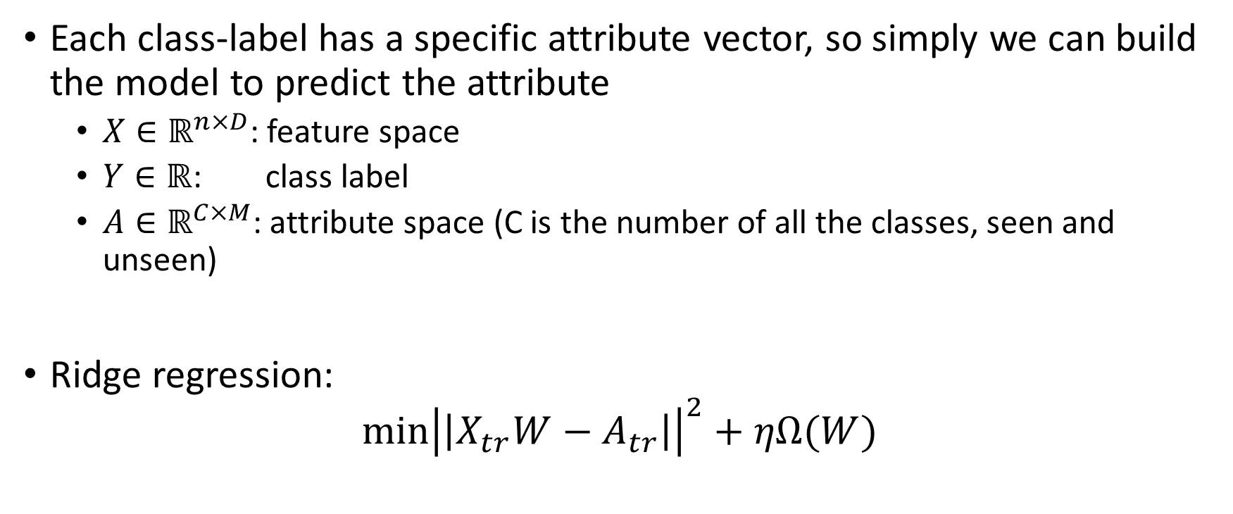
Simple idea on zero-shot learning
Each class-label has a specific attribute vector, so simply we can build the model to predict the attribute
$X∈ℝ^{n×D}$: feature space
$Y∈ℝ$: class label
$A∈ℝ^{C×M}$: attribute space (C is the number of all the classes, seen and unseen)
Ridge regression:
$$\min{{\left|\left|X_{tr}W−A_{tr}\right|\right|}^{2}+ηΩ(W)}$$

Slide 12

Simple idea on zero-shot learning
Semantic Autoencoder:
$$\min{{\left|\left|X_{tr}−W^{T}A_{tr}\right|\right|}^{2}+λ{\left|\left|WX_{tr}−A_{tr}\right|\right|}^{2}}$$
Intuition: reduce the information loss for feature mapping
Elyor Kodirov, Tao Xiang, and Shaogang Gong. "Semantic autoencoder for zero-shot learning." In Proceedings of the IEEE Conference on Computer Vision and Pattern Recognition, pp. 3174-3183. 2017.

Slide 13
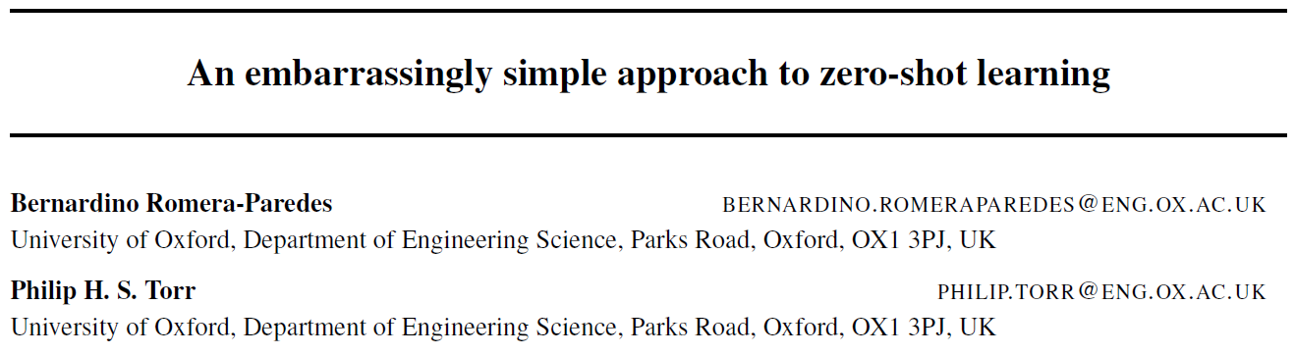
Bernardino Romera-Paredes, and Philip Torr. "An embarrassingly simple approach to zero-shot learning." In International Conference on Machine Learning, pp. 2152-2161. 2015.

Slide 14
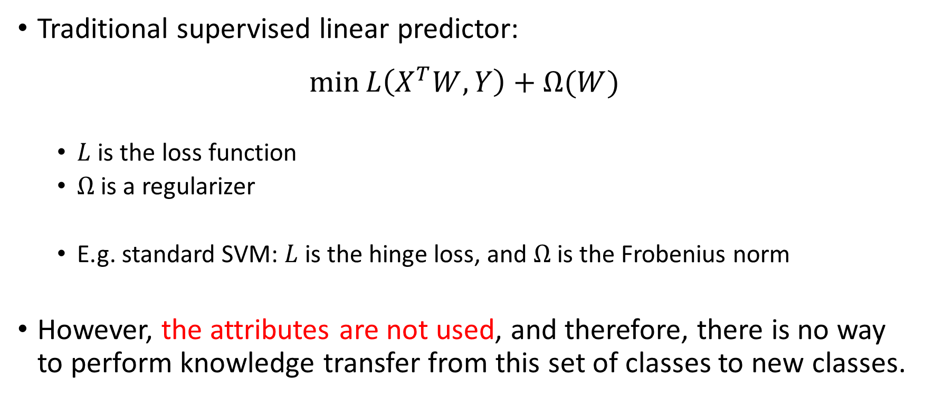
ESZSL
Traditional supervised linear predictor:
$$\min{L\left(X^{T}W, Y\right)+Ω(W)}$$
$L$ is the loss function
$Ω$ is a regularizer
E.g. standard SVM: $L$ is the hinge loss, and $Ω$ is the Frobenius norm
However, the attributes are not used, and therefore, there is no way to perform knowledge transfer from this set of classes to new classes.

Slide 15
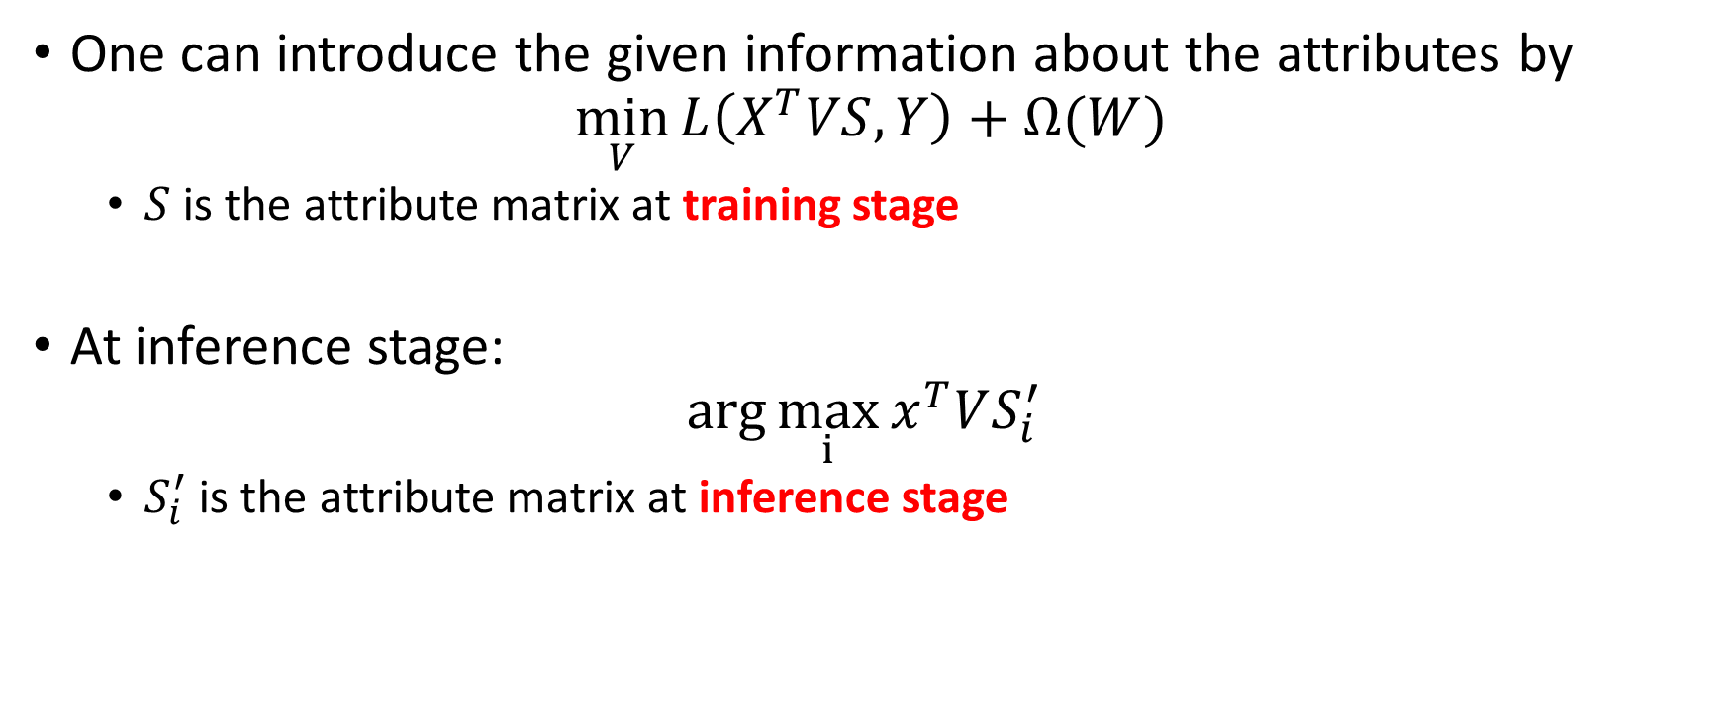
ESZSL
One can introduce the given information about the attributes by
$$\min_{V}{L\left(X^{T}VS, Y\right)+Ω(W)}$$
$S$ is the attribute matrix at training stage
At inference stage:
$$\arg{\max_{i}{x^{T}VS_{i}^{′}} }$$
$S_{i}^{′}$ is the attribute matrix at inference stage

Slide 16
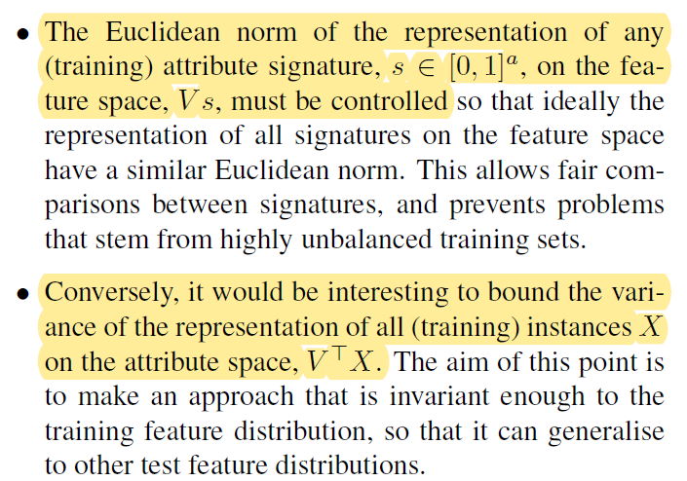
Regularization and loss function choices

Slide 17

Regularization and loss function choices
$$\min_{V}{L\left(X^{T}VS, Y\right)+Ω(W)}$$
where
$$Ω\left(V\right)=γ{\left\|VS\right\|}_{Fro}^{2}+λ{\left\|X^{T}V\right\|}_{Fro}^{2}+β{\left\|V\right\|}_{Fro}^{2}$$
$$L\left(P,Y\right)={\left\|P−Y\right\|}_{Fro}^{2}$$
$$β=γλ$$

Slide 18

Benefits
It has the closed solution:
$$V={\left(XX^{T}+γI\right)}^{−1}XYS^{T}{\left(SS^{T}+λI\right)}^{−1}$$

Slide 19
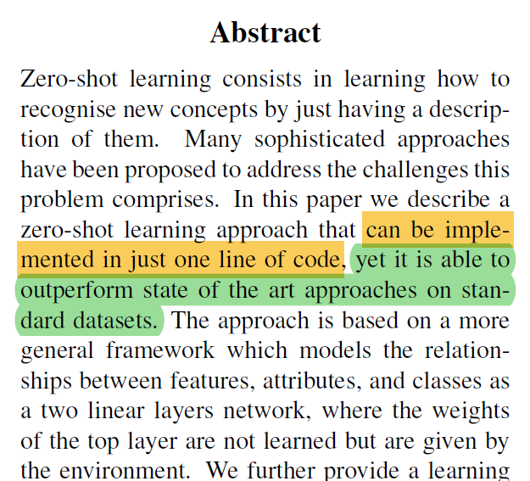
Benefits
It has the closed solution:
$$V={\left(XX^{T}+γI\right)}^{−1}XYS^{T}{\left(SS^{T}+λI\right)}^{−1}$$

Slide 20
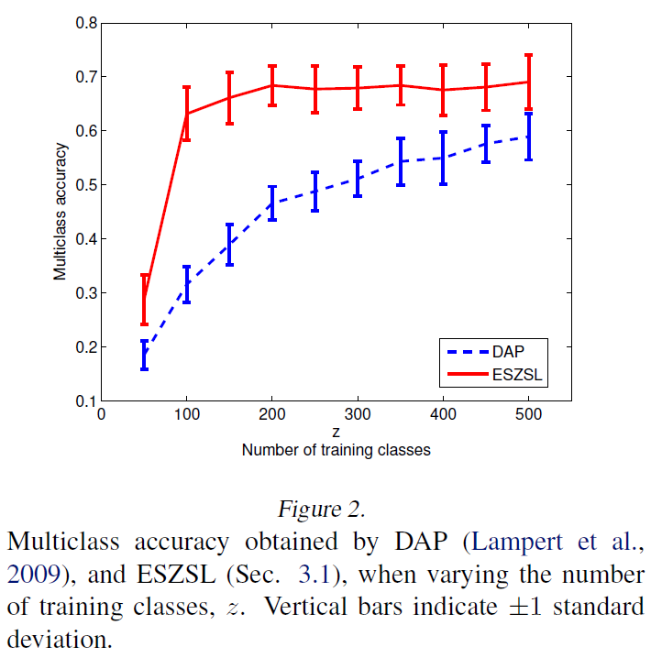
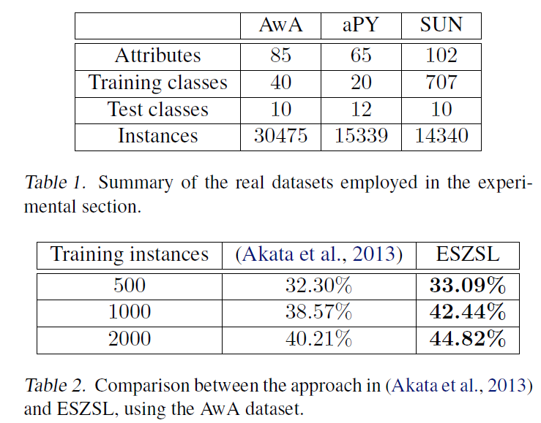
Experiments

Slide 21
Thanks
&
Questions or comments?

